Slide 1


Introduction to the ArcGIS Pro SDK
Esri Developer Summit
March 8–11, 2016 | Palm Springs, CA
Charles Macleod, Uma Harano

Slide 2

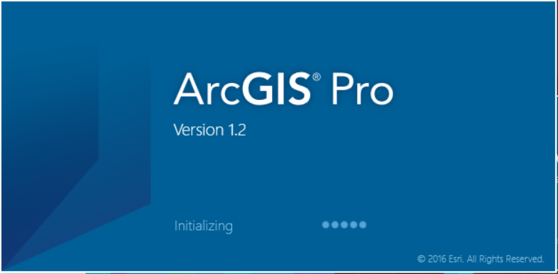
What is the ArcGIS Pro SDK?
Customization with Tasks
.NET Add-ins for extending Pro (C#, VB)
Arcpy for automating Pro (Python 3.4)
Modern asynchronous API (native .NET)
Resources
Samples, Concepts, Reference

Slide 3
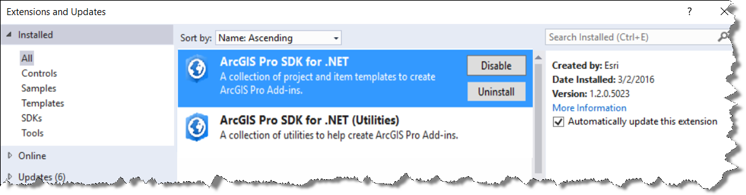
What is the ArcGIS Pro SDK for .NET?
Easy to use project templates and wizards (in the Visual Studio 2013 IDE)
New installation experience
Integrated with VisualStudio gallery

Slide 4
What is the ArcGIS Pro SDK for .NET?
.NET APIs exposed by the Pro Extensions (Installed as part of Pro)
Modern API
Native .NET
UI is WPF and XAML
Core
Catalog
Mapping
Layout
Editing
Sharing
Search
GP
Raster
GDB
…
Notes:
May want to show the extensions on disk
C:\Program Files\ArcGIS\Pro\bin contain the API extensions
Look at DAML files to see how components of Pro are put together.

Slide 5
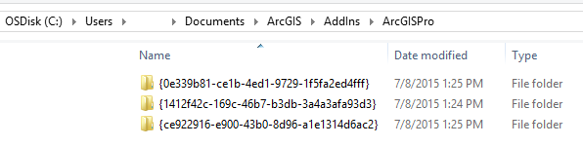
.NET Add-ins for extending Pro
Declarative framework for creating a collection of customizations
Conveniently packaged within a single compressed file (.esriAddInX)
Easy to share between users
Installs to a well known folder location
Consists of
A module
An xml Configuration file (Config.daml)
and code files
Notes:
Deployed add-ins stored here: C:\Users\Evan\Documents\ArcGIS\AddIns\ArcGISPro
Change .esriaddinx file to .zip and you can see what’s inside it.

Slide 6
Fundamentals
Fundamentals
Module
DAML
Plug Ins
States and Conditions

Slide 7
Module
Hub and central access point for a subsystem
Similar to the Extension object used in the 10.x framework
Singletons instantiated automatically by the Framework
internal class Module1 : Module {
private static Module1 _this = null;
/// <summary>
/// Retrieve the singleton instance to this module here
/// </summary>
public static Module1 Current{
get
{
return _this ?? (_this = (Module1)FrameworkApplication.FindModule("ProAppModule7_Module"));
}
}
Notes:
Basic Add-in

Slide 8
Config.daml
Declarative add-in definition
Configuration file that contains framework elements (buttons, dockpane, galleries)
Uses XML Syntax
<ArcGIS defaultAssembly="WorkingWithDAML.dll" defaultNamespace="WorkingWithDAML"
xmlns="http://schemas.esri.com/DADF/Registry"
xmlns:xsi="http://www.w3.org/2001/XMLSchema-instance"
xsi:schemaLocation="http://schemas.esri.com/DADF/Registry
file:///C:/Program%20Files/ArcGIS/Pro/bin/ArcGIS.Desktop.Framework.xsd">
<AddInInfo id="{c6226a24-d69b-46c6-b5e7-9eee4ddad45d}" version="1.0" desktopVersion="1.1.2850">
…
</AddInInfo>
<modules>
<insertModule id="WorkingWithDAML" className="Module1" autoLoad="false" caption="Module1">
<tabGroups>
<!--The new Tab Group is created here-->
<tabGroup caption="Example State Solution" id="working_with_DAML_ExampleStateTabGroup">
<color A="255" R="238" G="170" B="90" />
<borderColor A="0" R="251" G="226" B="195" />
</tabGroup>
</tabGroups>

Slide 9
Config.daml (continued)
Defines the changes to the ArcGIS Pro UI.
Mostly additions, but can also alter or remove elements in other modules
<!--Modifying Core Map Tab-->
<updateModule refID="esri_mapping">
<groups>
<updateGroup refID="esri_mapping_navigateGroup">
<deleteButton refID="esri_mapping_bookmarksNavigateGallery"></deleteButton>
<insertButton refID="working_with_DAML_ToggleStateButton" />
</updateGroup>
</groups>
</updateModule>
</modules>
</ArcGIS>

Slide 10
Demo
Notes:
Tabs, groups, controls stubbed out for you.
New button added to DAML when you add button in VS
/dumpcombineddaml

Slide 11
Config.daml
DAML is transactional
3 distinct actions:
Insert
Update
Delete
The type of operation is determined by the element name.
<insertButton id="esri_Subsystem_Button1" className="TestButton" caption="Test“/>
<updateGroup refID="esri_mapping_navigateGroup">... </updateGroup>
<deleteButton refID="esri_mapping_bookmarksNavigateGallery“/>
<insertModule refID="esri_mapping">
Note: At 1.2 use the command line option /dumpcombineddaml to generate a complete daml file in your temp folder.

Slide 12
Plug-Ins
Many customizations are purely declarative
Eg Menus
Others (such as ‘Controls’) have an active (code-behind) component
Inherit from common base class PlugIn
Most methods and properties do not need to be overridden
Provided by the DAML
Most Controls generated automatically “out-of-the-box” by the SDK
public abstract class PlugIn : PropertyChangedBase {
public string Caption { get; set; }
public string DisabledTooltip { get; set; }
public bool Enabled { get; set; }
protected internal string ID { get; }
...
Notes:
It is only in rare cases that controls need to be edited by hand. The SDK templates do most of the work for us.

Slide 13
Demo

Slide 14
Plug-Ins (Controls)
Cannot exist “un-tethered” or “stand-alone”
They have to be defined in a Module
Require a unique ID
Have a code behind file (or “class” file) linked to the DAML
<insertButton id="esri_Subsystem_Button1" className="TestButton" caption="Test“/>
public sealed class TestButton : Contracts.Button {
protected override void OnClick() {
this.Caption = “New Caption”;
this.Tooltip = “New Tooltip”;
this.Checked = true;
}
...
Notes:
PlugIns cannot survive outside of a Module. They must be defined within it.

Slide 15
Delegate Commands
A pattern for simplifying the creation of buttons
Declare the button as a static method in the Module
OnUpdate logic can be implemented as a static bool “getter” property
<insertModule id="WorkingWithDAML" className="Module1" autoLoad="false" caption="Module1">
....
<insertButton id=“TestButton1" className=“WorkingWithDAML:OnCustomButtonClick" caption="Test“/>
internal class Module1 : Contracts.Module {
internal static void OnCustomButtonClick() {
IPlugInWrapper wrapper = FrameworkApplication.GetPlugInWrapper("TestButton1");
wrapper.Caption = "New Caption";
wrapper.Tooltip = "New Tooltip";
//TODO - something on click...
}
internal static bool CanOnCustomButtonClick {
get { return true; }
}
Notes:
This will be in the lab 2 along with Conditions and States
Go back to Basic Add-in demo

Slide 16
Demo

Slide 17
States & Conditions
Simplifies coding by reducing event wiring associated with more traditional models.
Example: A button is activated only when a “example_state_condition” is met.
States
are named values which describes a particular aspect of the application’s overall status.
Activate or deactivate in code
Conditions
Declared in DAML
Expressions composed of one or more states
AND, OR, NOT
Used for triggering the activation of framework elements.

Slide 18
States and Conditions (continued)
<conditions>
<insertCondition id="example_state_condition" caption=“Custom Condition">
<state id="example_state" />
</insertCondition> </conditions>
if(FrameworkApplication.State.Contains(“example_state”)
FrameworkApplication.State.Deactivate(“example_state”);
else
FrameworkApplication.State.Activate(“example_state”);
<!-- associate our condition with the enabled state of the button -->
<button id="esri_sdk_RespondToAppStateBtn" caption="Respond to state"
condition="example_state_condition">
</button>
Notes:
Conditions control either enabled/disabled state (Ribbon controls) or visibility (tabs, tab groups, dock panes)
Individual states are combined using Boolean operators to create conditions. Conditions are true when all the combination of their contained states evaluate to true. An individual state is only true when it is activated.
Questions:
1. Dev guide has this: <conditions>
<condition name="aSimpleCondition">
<state name="someState"/>
</condition>
</conditions>
2. In ADMapping.daml, couldn’t find condition for “esri_mapping_mapPane”
Only a state.

Slide 19
Demo
Notes:
Pro has a lot of conditions out of the box, controlled with AND, OR, NOT

Slide 20
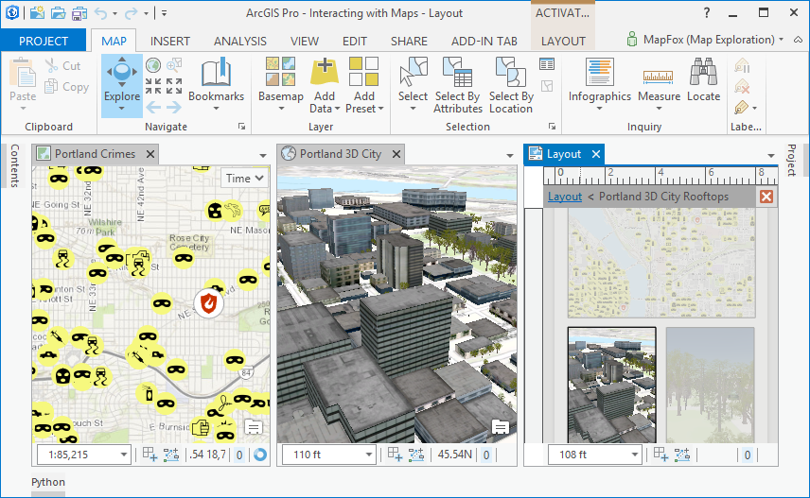
States & Conditions (continued)

Slide 21
States and Conditions (continued)
<!--Some conditions from ADMapping.daml in Pro-->
<conditions>
<insertCondition id="esri_mapping_mapPaneOrLayoutPane">
<or>
<state id="esri_layouts_layoutPane"/>
<state id ="esri_mapping_mapPane"/>
</or>
</insertCondition>
<insertCondition id="esri_mapping_singleLayerSelectedCondition"
caption="A single layer is selected">
<and>
<state id="esri_mapping_layerSelectedState" />
<state id="esri_mapping_singleTOCItemSelectedState" />
<not>
<state id="esri_mapping_groupLayerSelectedState" />
</not>
</and>
</insertCondition>
Notes:
Questions:
1. Dev guide has this: <conditions>
<condition name="aSimpleCondition">
<state name="someState"/>
</condition>
</conditions>

Slide 22




